Slide 1
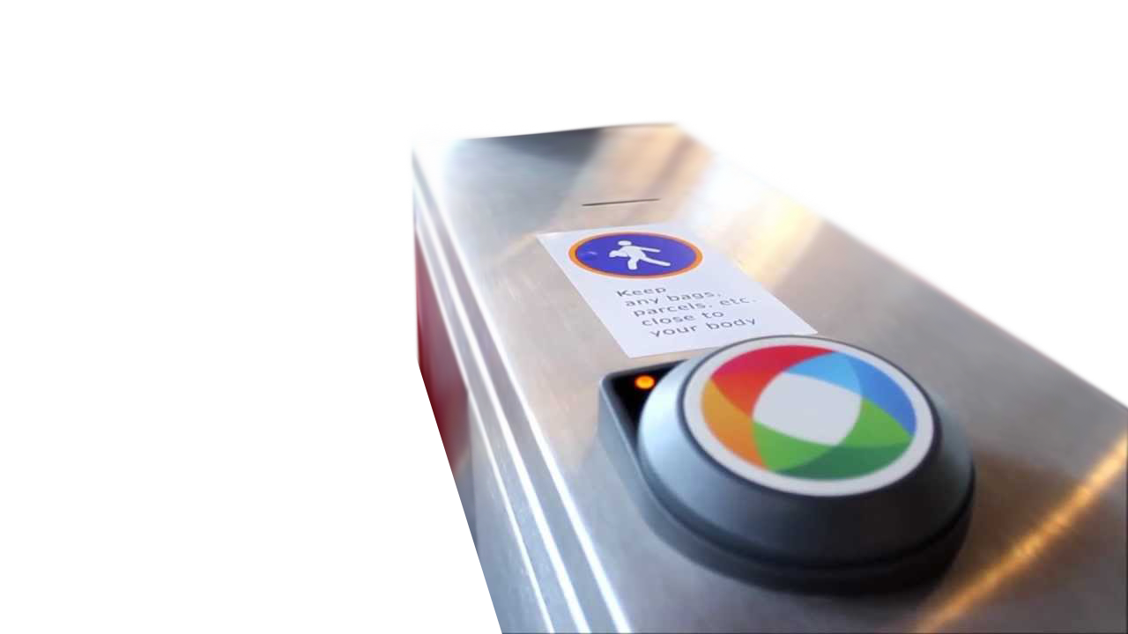

Opal.com.au UX review & strategy
Nav 22nd 2013
Author: Vlad Ivanovic

Slide 2
Objective of meeting
Clarify copy scope based on UX strategy
UX strategy
Copy scope
Copy
We are here

Slide 3
Agenda
Primary user journeys
Key page review
Global element review
Recommended IA & wireframes
Discussion

Slide 4
Key recommendations
Simplify copy, user experience and user interface
Allow for scan reading
Enable users to get more information if required
Give the right information at the right point in time
Prioritise key information
Differentiate experience based on:
Logged in: card admin
Logged out: retail

Slide 5
Primary user journeys

Slide 6
Outstanding questions
Do we know % of rollout completion?
Search term use
- Do people do searches?
- What do they search for?
Mobile visitors?
How were FAQs compiled?
What elements of the site need to be updated regularly?
How much information do people need prior to purchasing?
How do we find out where the Opal card is active?
Search terms people are using to get to the site?

Slide 7

Rick Fletcher – set and forget
Rick is a 33 year old senior sales rep for Telstra. He has a daily commute from Crows Nest into the city to the Telstra building.
Rick likes the idea of the Opal Card as it makes his life easier. Before he starts using the card he wants to make sure it covers his daily commute and is cheaper/the same price he’s currently paying.
“Tell me what I need to know, when I need to know it”

Slide 8
Key user goals
As a { local | tourist } I want to { order | find out more about } an Opal card
Is an Opal card useful to me?
Active where I travel?
Is an Opal card better than what I’m using now?
Cheaper? Easier?
As an Opal card user I want to manage my card
Balance: view, activity, top up
Activate/deactivate

Slide 9
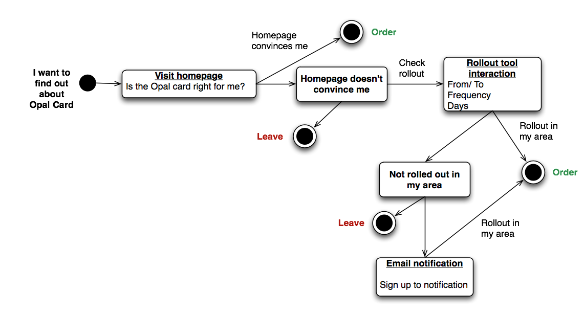
As a local I want to find out about the card
Recommendation: focus homepage on converting to order

Slide 10
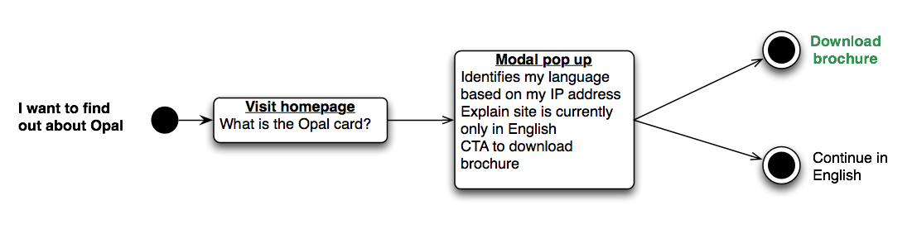
As an international tourist I want to find out about the Opal Card
Recommendation: identify international visitors via IP

Slide 11
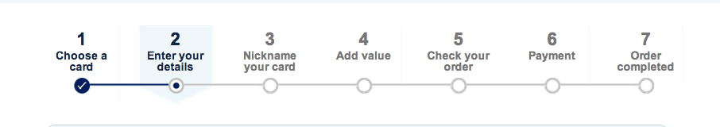
As a local I want to order the card
Recommendation: 7 steps to 2 steps
Consolidate into payment
Remove
Remove
Remove

Slide 12
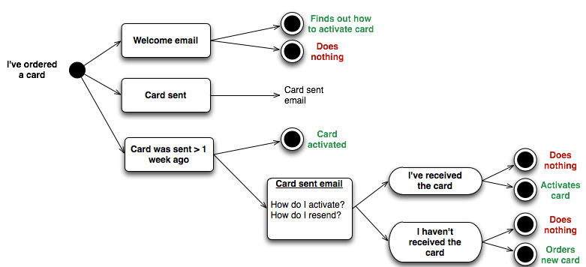
As a new customer I want to activate my card
Recommendation: send onboarding emails based on stage in activation process

Slide 13
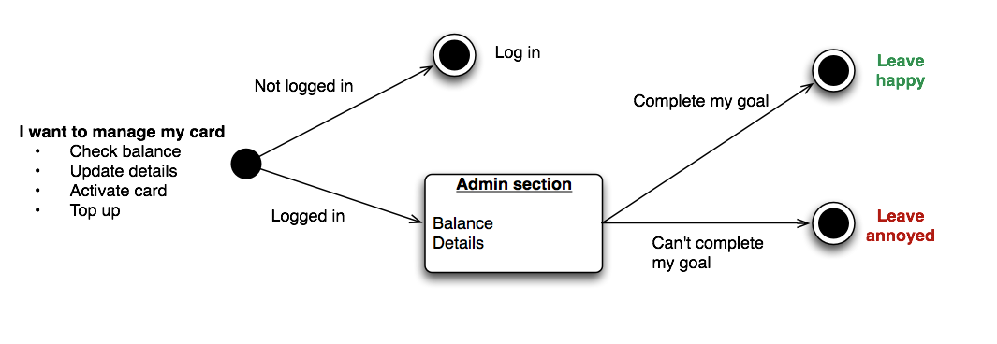
As a card owner I want to manage my card
Recommendation: consolidate management into key admin panel

Slide 14
Key page review

Slide 15
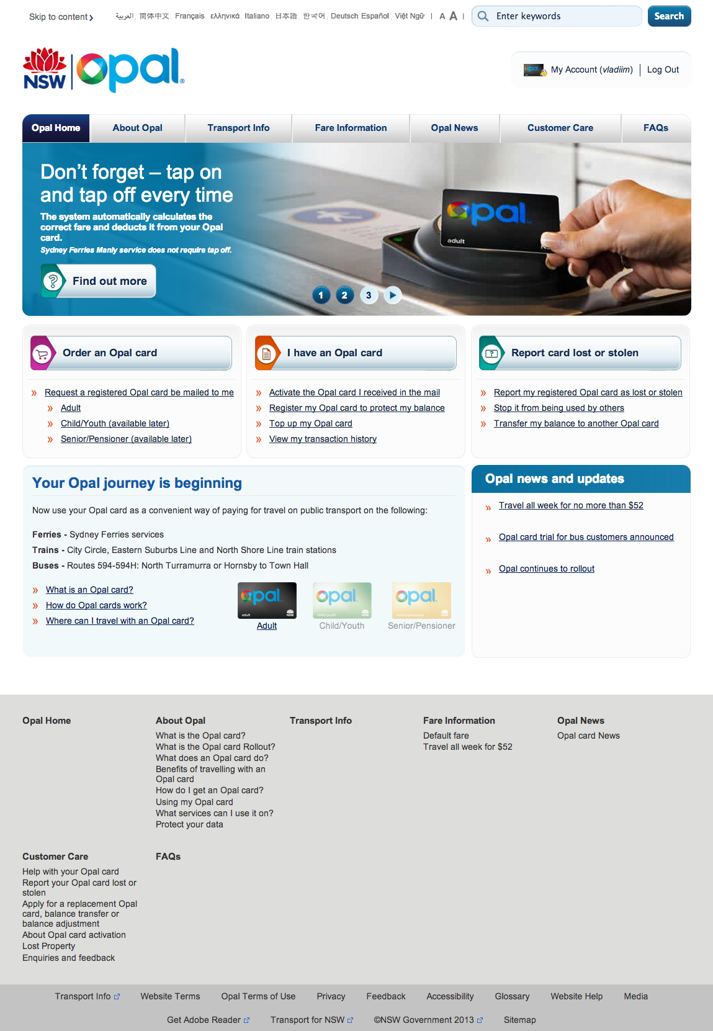
/ (home)
Comments | Very busy, too many links, too much information Hard to quickly scan
User flows | Primary retail flow
Recommendations | Copy Product single minded prop delivered creatively, e.g. ‘All NSW transport, one card’ Key F&Bs (default fare) CTA: ORDER NOW Remove secondary and tertiary information and CTAs Information on where Opal card is active Add % rolled out e.g. 50% rolled out, complete rollout expected in 2 months Non-copy Use high-quality image, illustration or video that demonstrates product One key CTA No carousel If the user is logged in they should see their account page on the homepage
What is the Opal Card?
Is it right for me?
What % is rolled out?

Slide 16
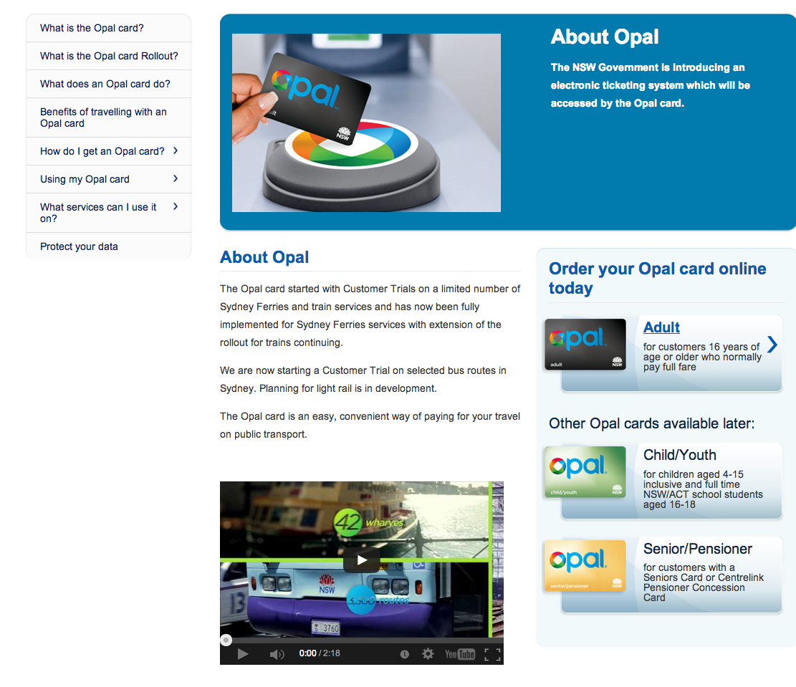
/en/about-opal/ (About Opal)
Comments | Information is nice-to-have and doesn’t help users make a purchase decision
User flows | Not in primary user flow
Recommendations | Copy Don’t use ‘Opal’ in title Move information on rollout to key module Remove the majority of this information Non copy Consolidate information Remove unnecessary information

Slide 17
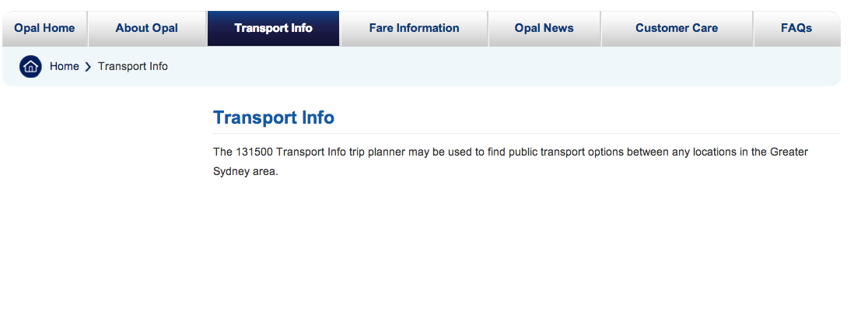
/en/transport-info/ (Transport Info)
Comments | Redundant
User flows | Not in primary user flow
Recommendations | Consolidate elsewhere and remove

Slide 18
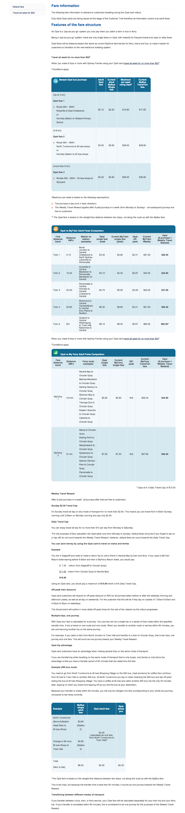
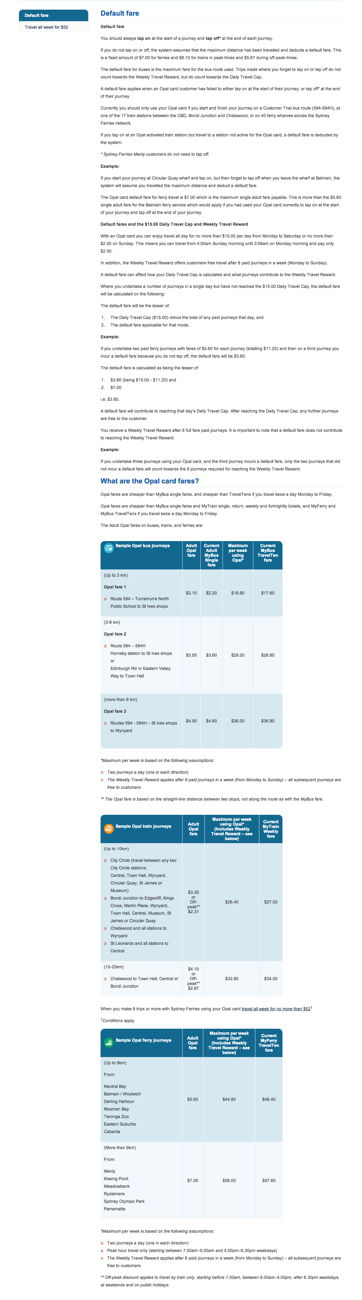
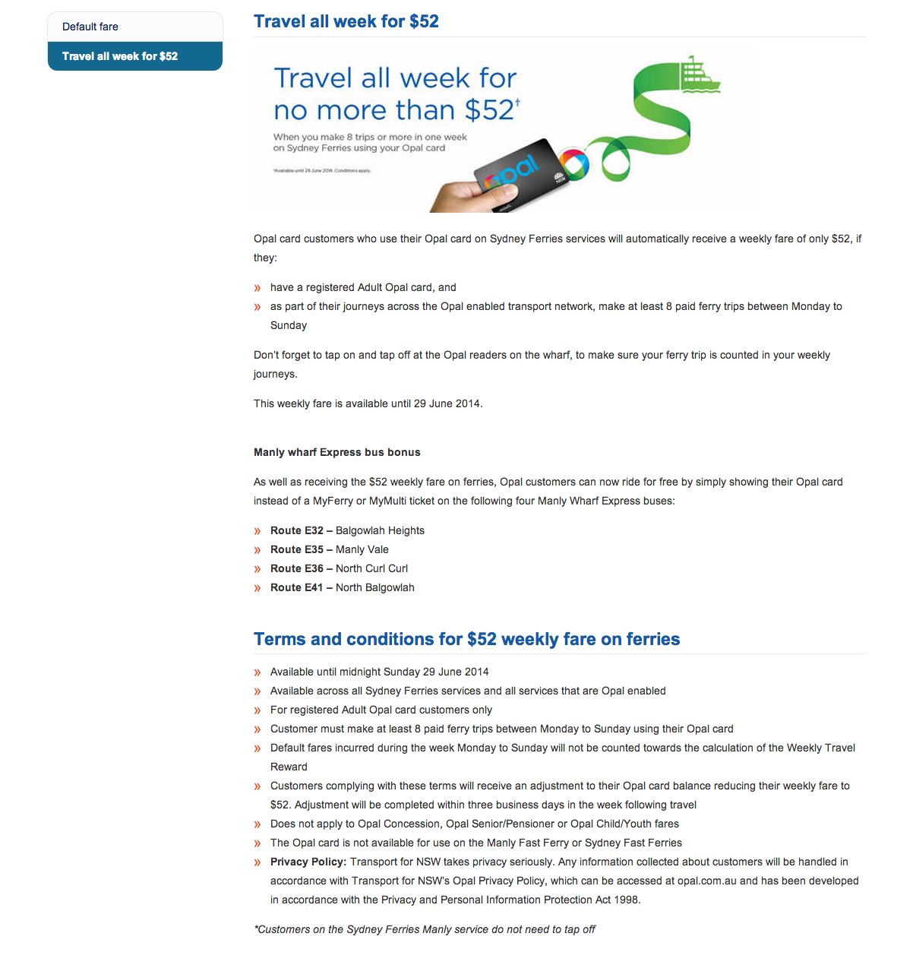
/en/fare-information/ (Fare Information)
Index
Default fare
Travel all week for $52
Comments | Huge amount of static information Hard to read or understand Not intuitive Difficult to relate to my needs
User flows | Critical in understanding if the service meets my requirements
Recommendations | Copy Make the information dynamic rather than static (from -> to, calc) Default fare as key homepage benefit

Slide 19
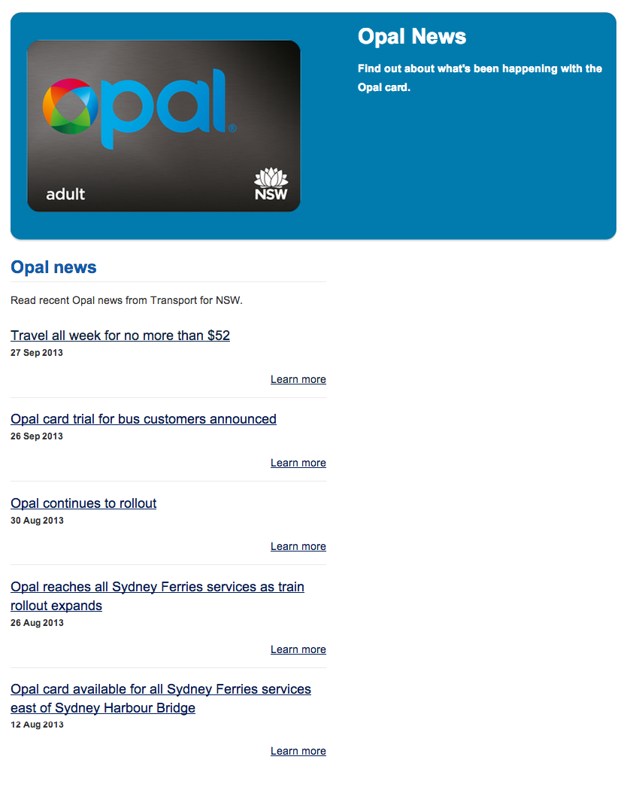
/en/news/ (Opal News)
Comments | Huge amount of static information Hard to read or understand Not intuitive Difficult to relate to my needs
User flows | Critical in understanding if the service meets my requirements
Recommendations | Copy Make the information dynamic rather than static (from -> to, calc) Default fare as key homepage benefit

Slide 20
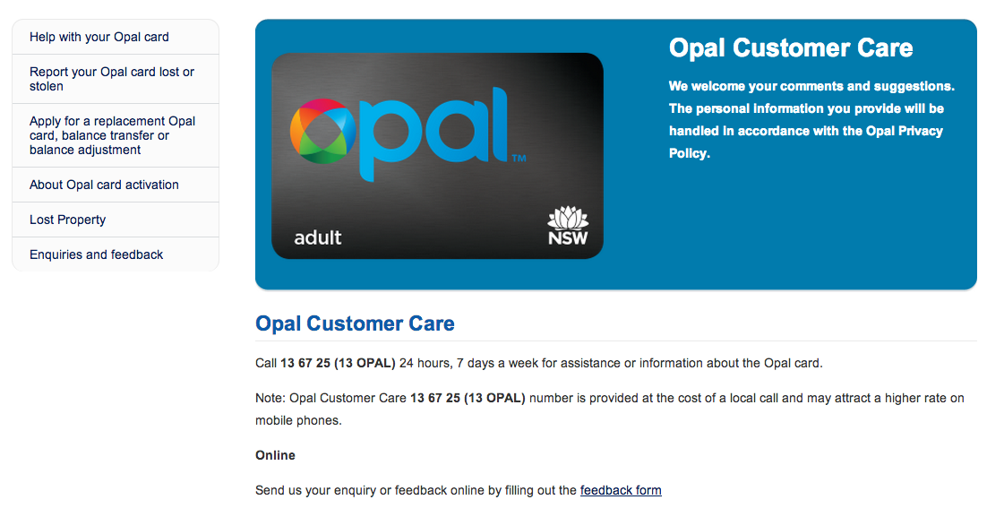
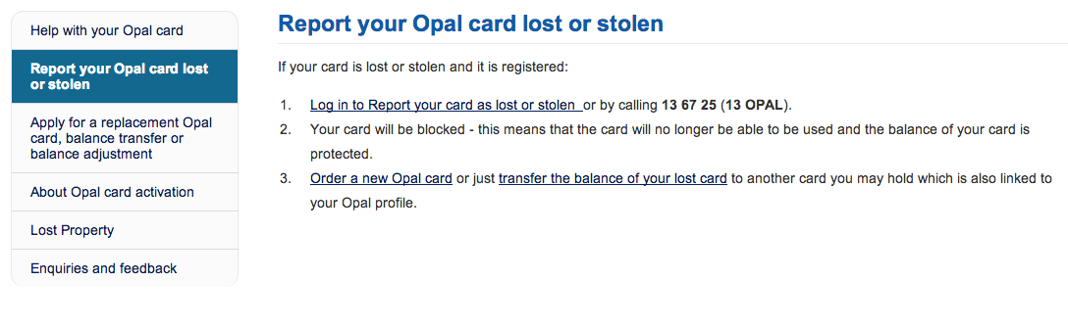
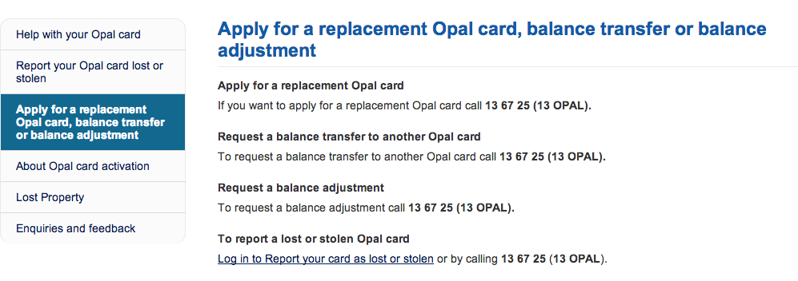
/en/customer-care/ (Customer Care)
Comments | Redundant information Not required unless user is logged in
User flows | Redundant, covered in ‘card admin’ use case
Recommendations | Copy Remove information Consolidate in sections where required Card admin Enquiries

Slide 21
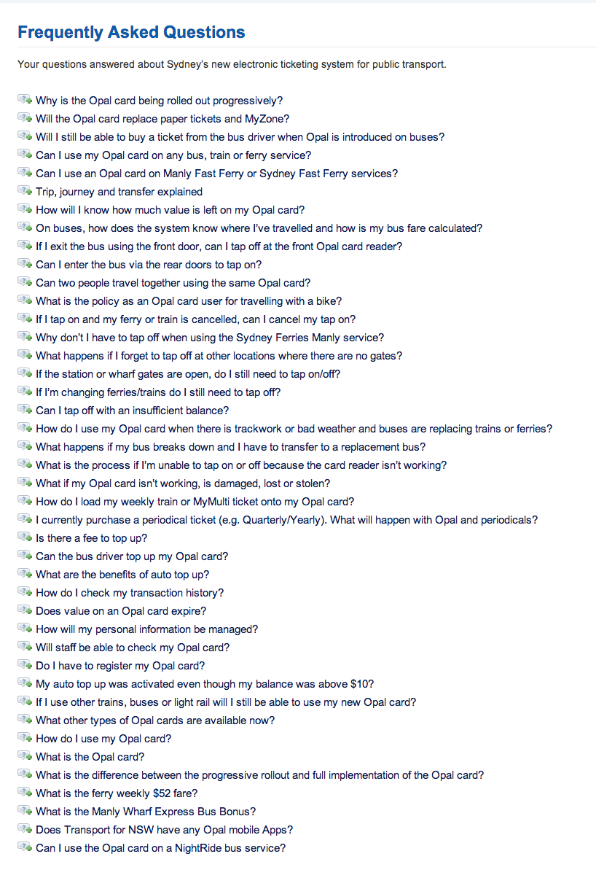
/en/faqs/ (FAQs)
Comments | Factual content Has value if it’s being used
User flows | Not part of primary user flow
Recommendations | Copy Review from POV of tone and voice

Slide 22
Global element review

Slide 23
Header/navigation
30%
70%
Take up 10% of fold
Stick to the top of the browser with scrolling
Add drop downs & remove LHS sub-navigation at the page level

Slide 24
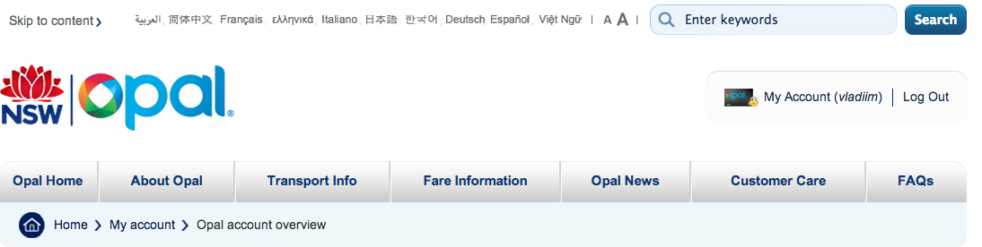
Tourists
IP detection
Serve international options
Copy in language of origin

Slide 25
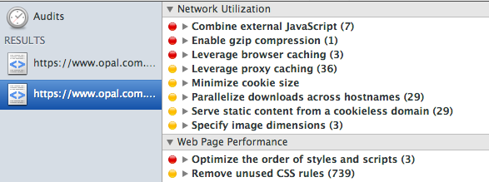
Speed
Small site, ~800kb pages
But slow, >4 second load time
55 page requests (make this smaller)
Use content delivery network (CDN)
Slower than >60% of web based on tools.pingdom.com

Slide 26
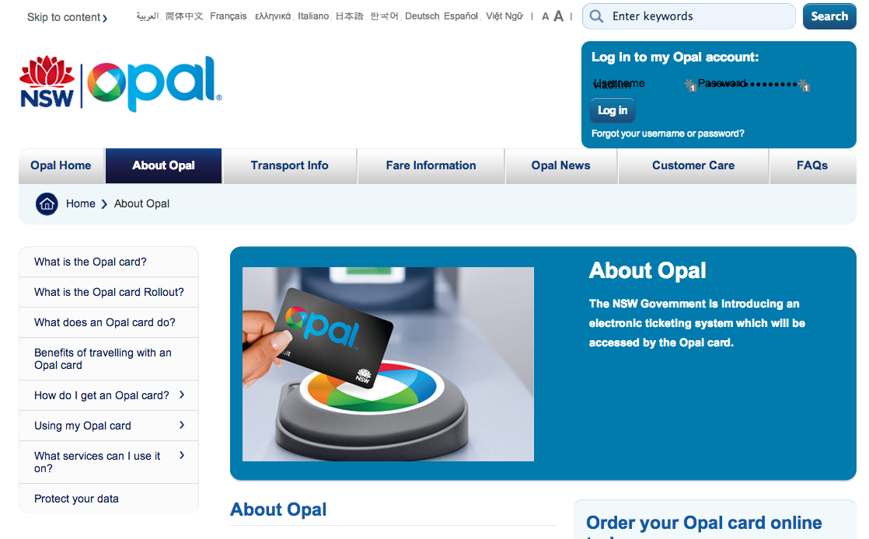
Layout
Currently two columns
Allowing space for sub-nav
Doesn’t require sub-nav
This should be a dropdown in the nav

Slide 27
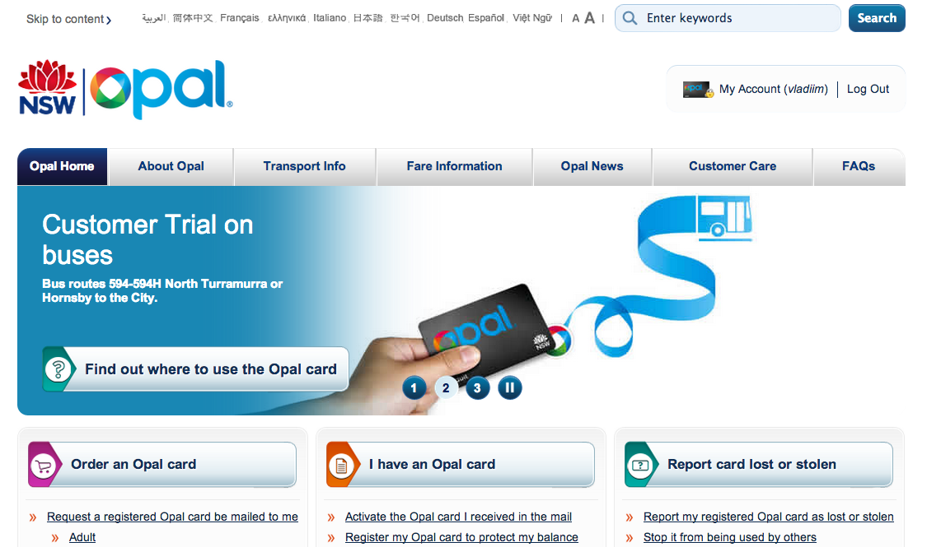
The 1st prominent link on your site
Takes people elsewhere!

Slide 28
Footer
Restating navigation
Poor design
Not categorised

Slide 29
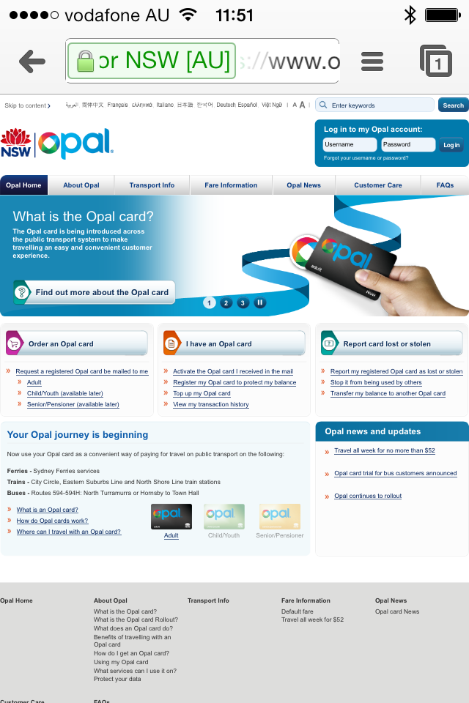
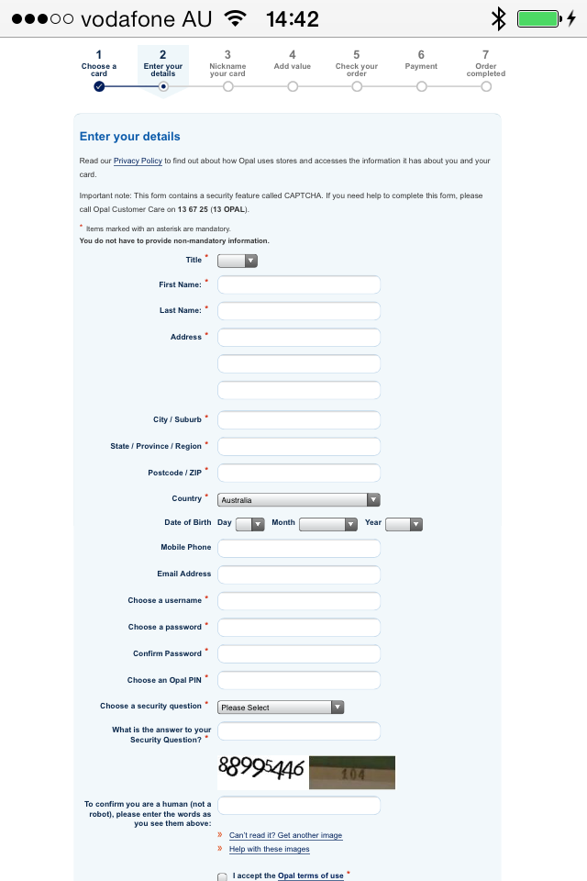
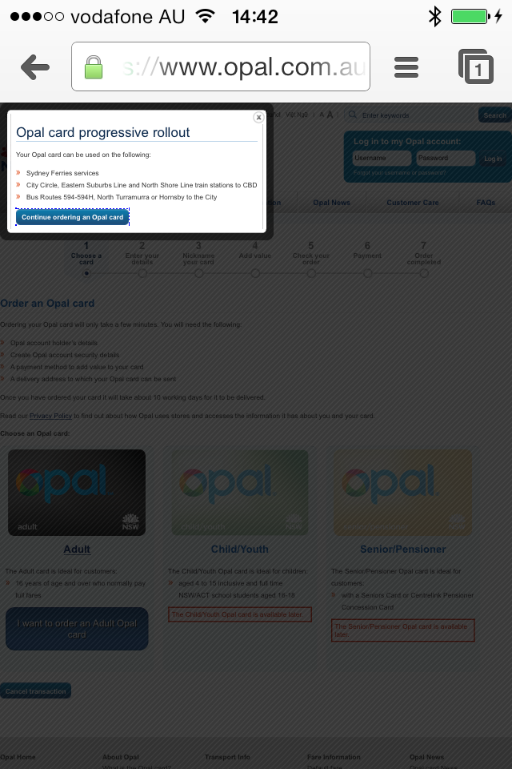
Mobile

Slide 30
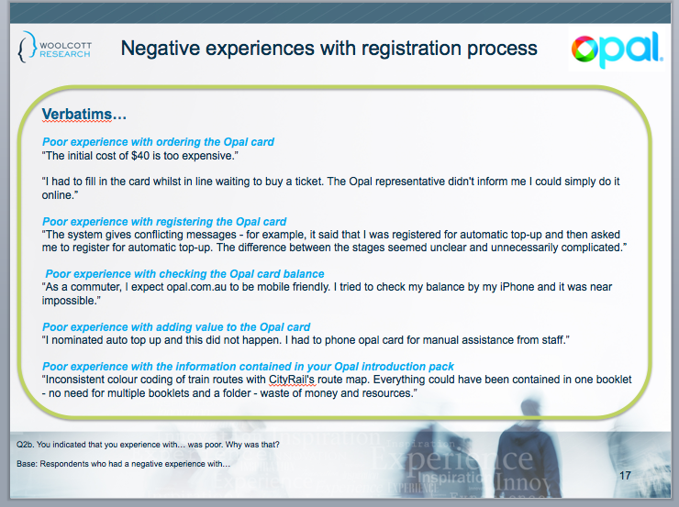
Mobile

Slide 31
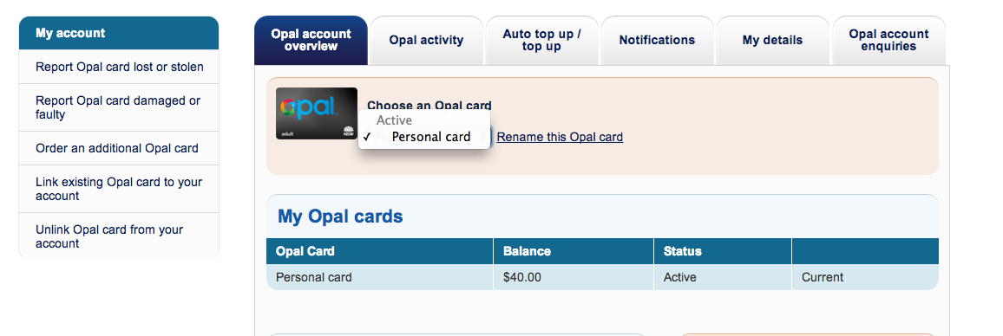
If I have one card this isn’t required

Slide 32
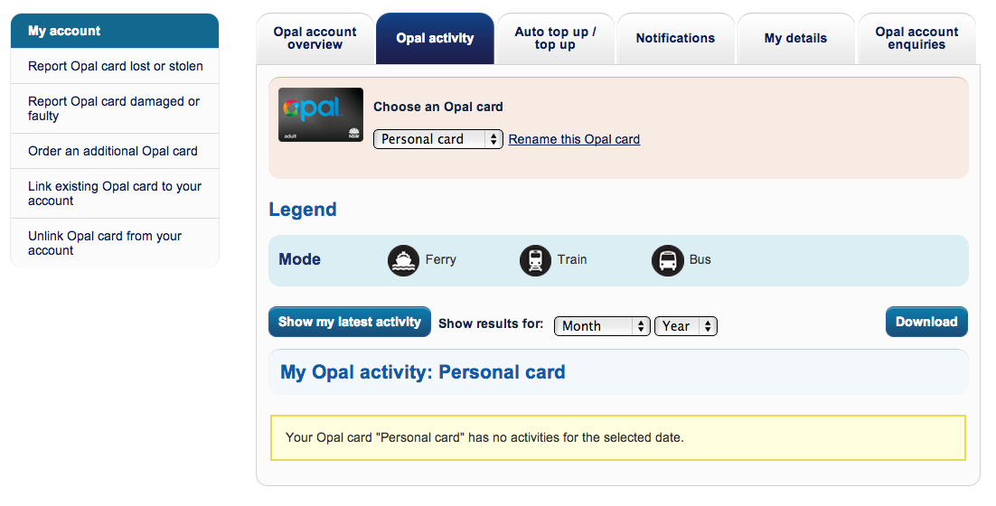
If there is no activity I shouldn’t see this

Slide 33

Allow user’s to change their details at all times
Can’t g back and change details

Slide 34
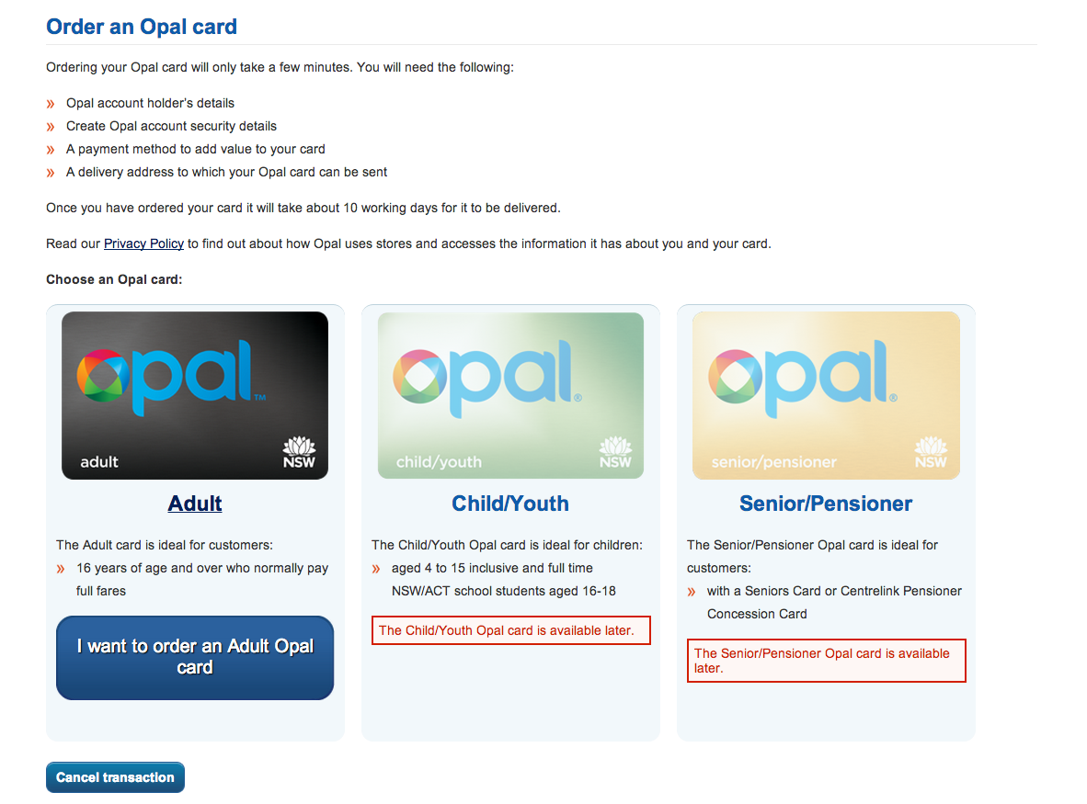
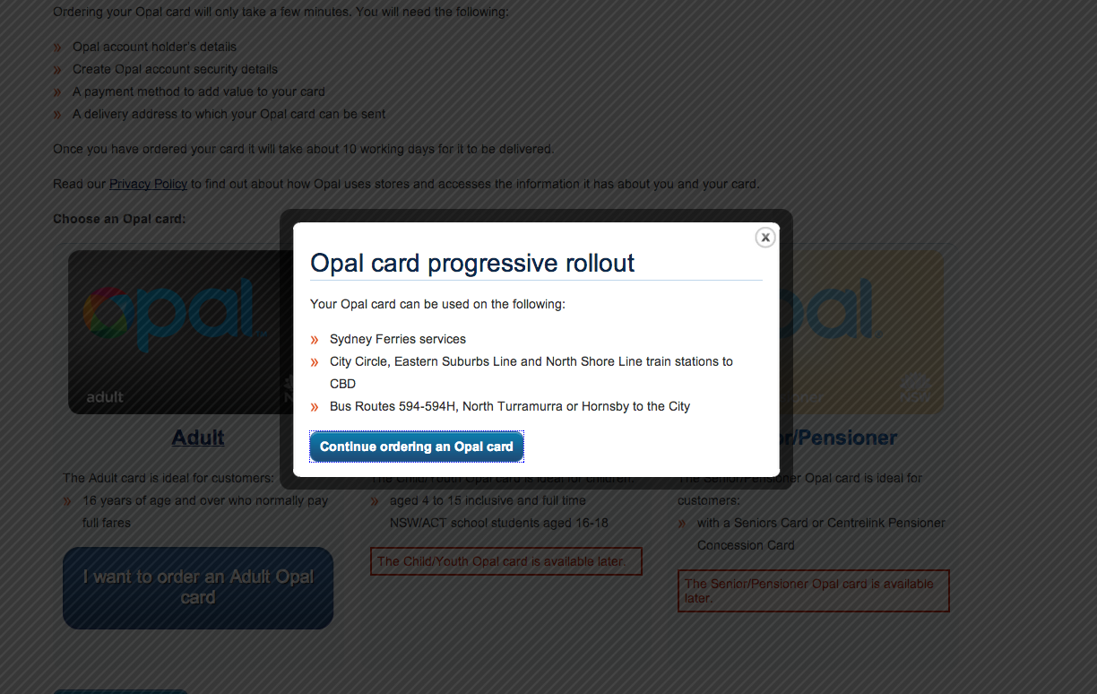
Redundant information

Slide 35
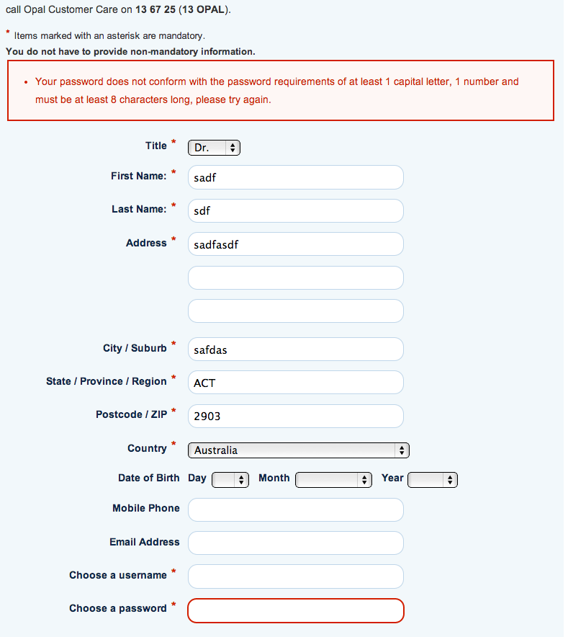
Bad validation!

Slide 36
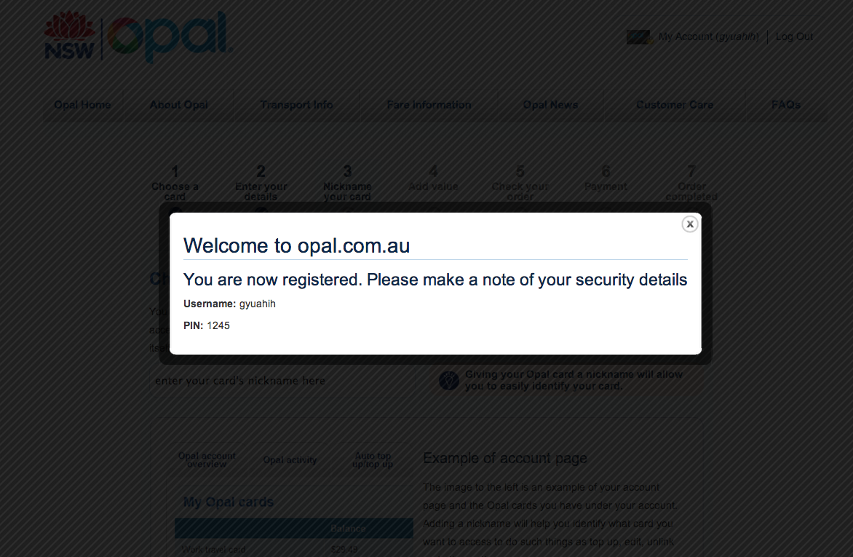
Insecure – pin stored as plain-text

Slide 37
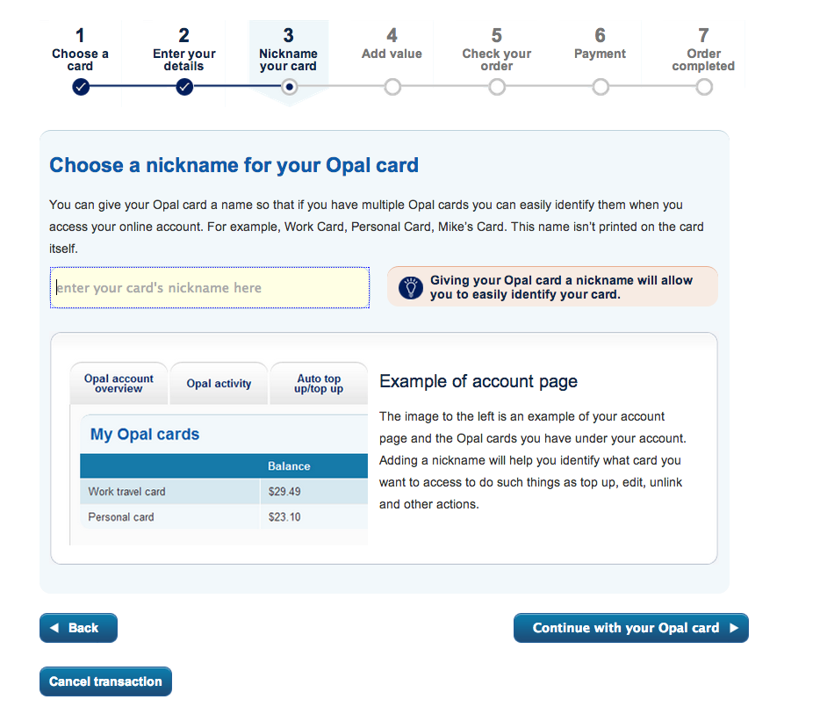
No need to nickname card at this stage

Slide 38
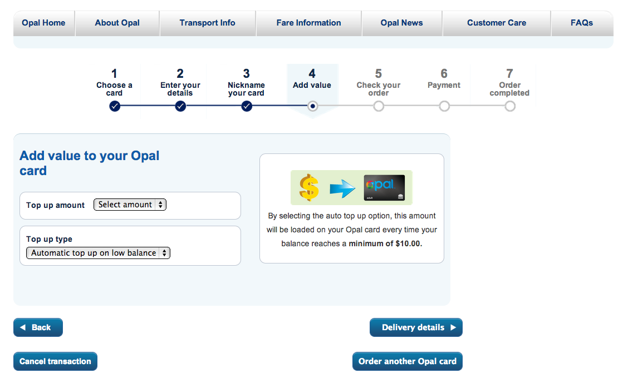
This step is redundant, can be integrated with payment

Slide 39
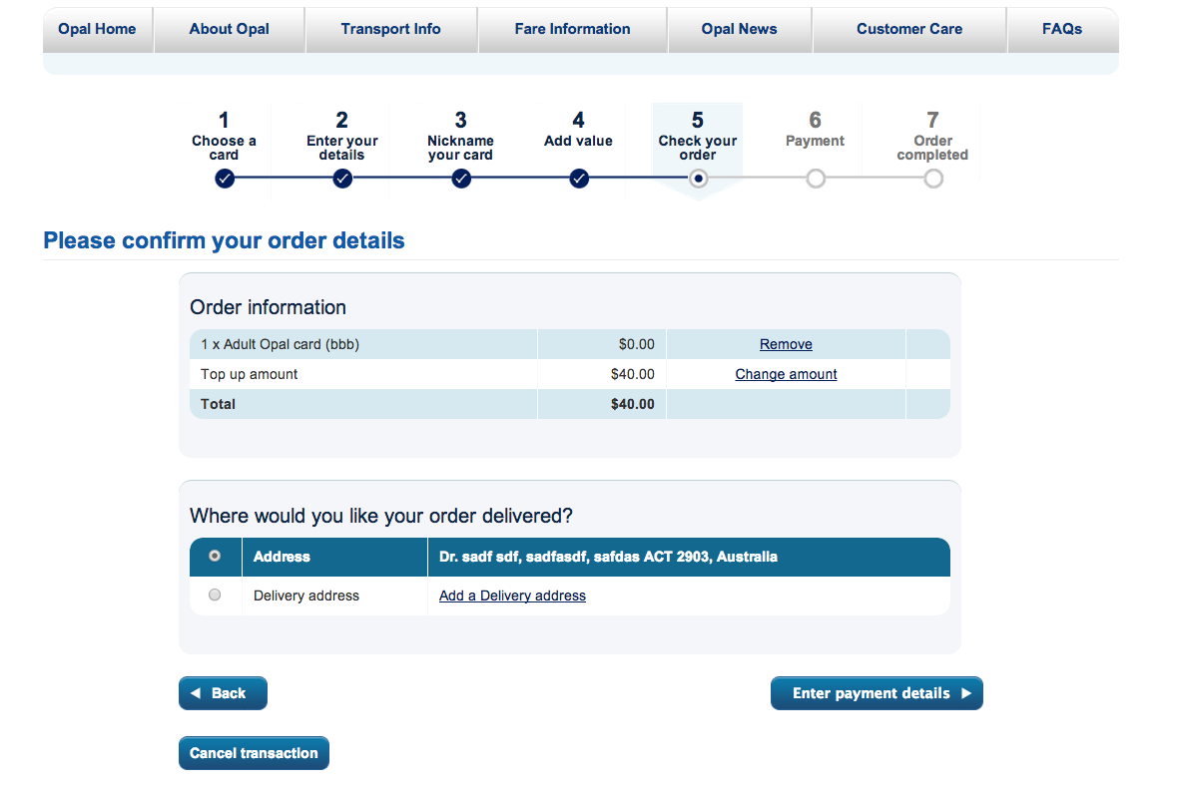
This step is redundant, can be integrated with payment
No address validation

Slide 40
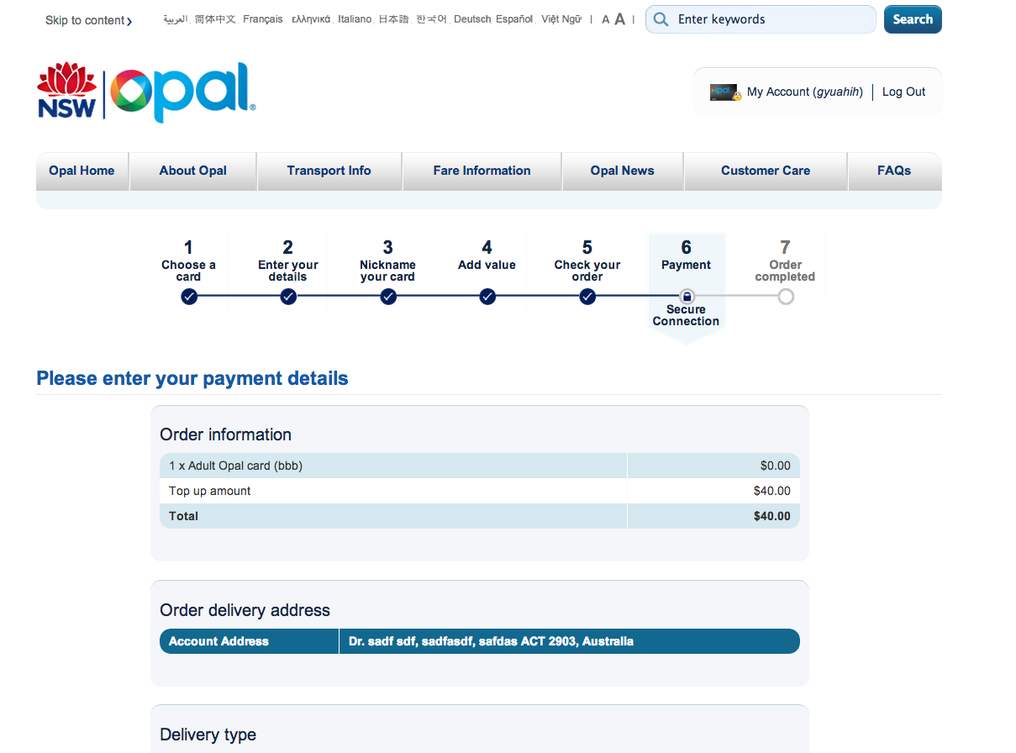
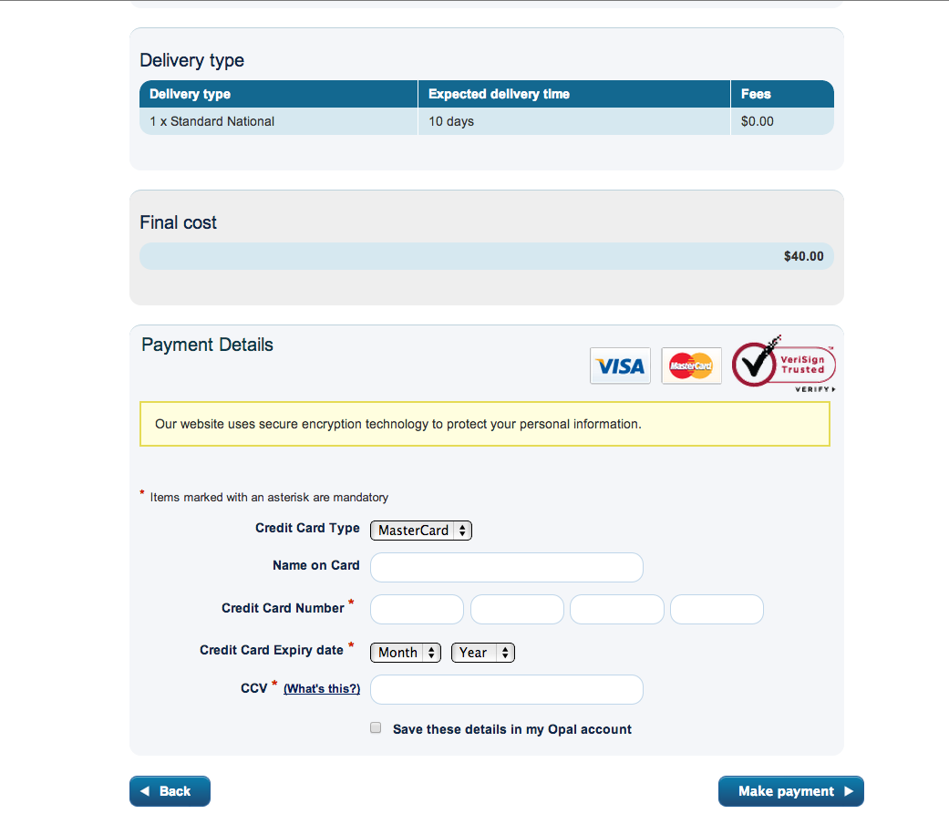
Payment below fold!
95% of page: Nice to know
5%: What I care about

Slide 41
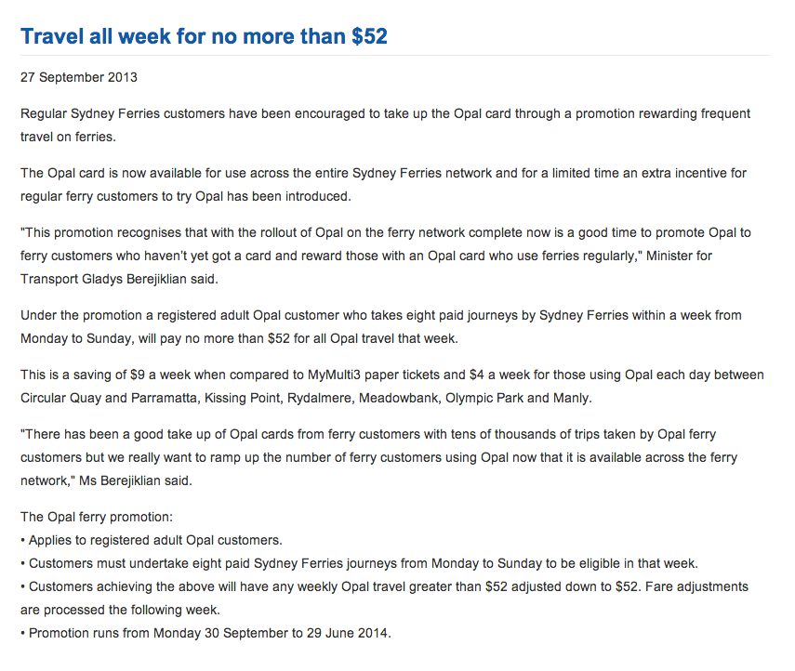
News
More engaging
More frequent
Tell the story of the rollout and people behind it
Design font for readability and legibility

Slide 42
Recommended solutions

Slide 43
Calculator
I’m traveling from Bondi Junction to Parramatta single trip on a Saturday.
Notify me when this route is covered by Opal your@email.com.
Your fare: $6.70 (?) Opal.
Route 594 – 594H bus

Slide 44
Calculator
I’m traveling from Edgecliff to Circular Quay return on weekdays.
Your fare: $52 per week Opal.

Slide 45
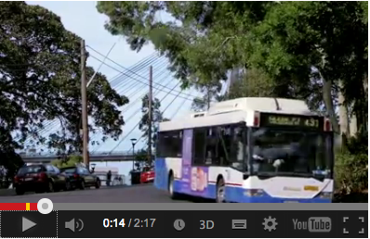
Video
Create customer-focused video

Slide 46
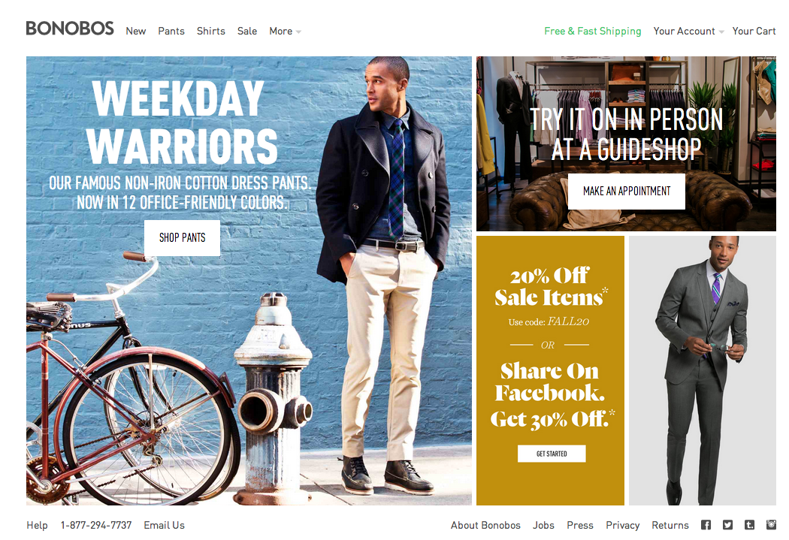
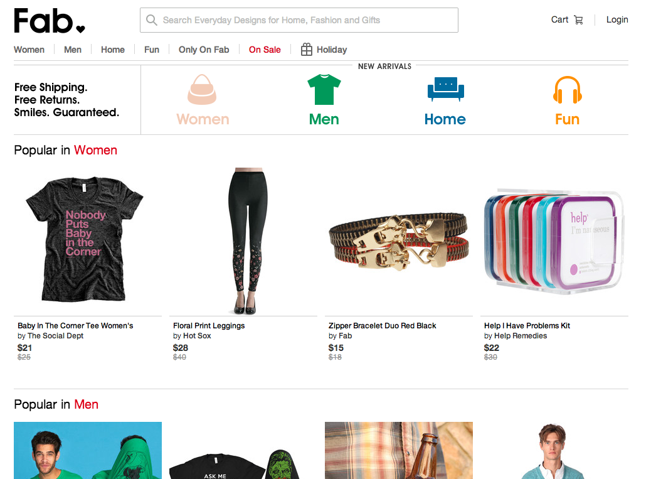
Design for scanning

Slide 47
IA & wires

Slide 48
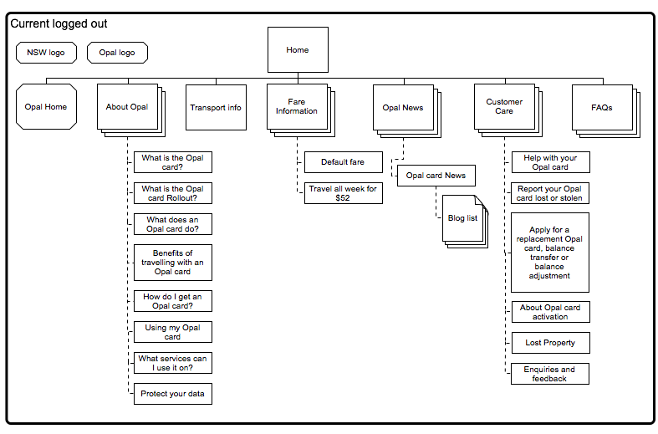
Current logged out

Slide 49
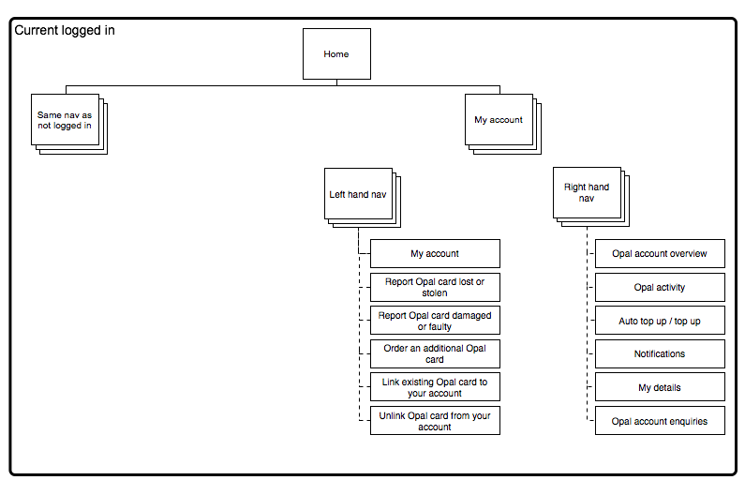
Current logged in

Slide 50
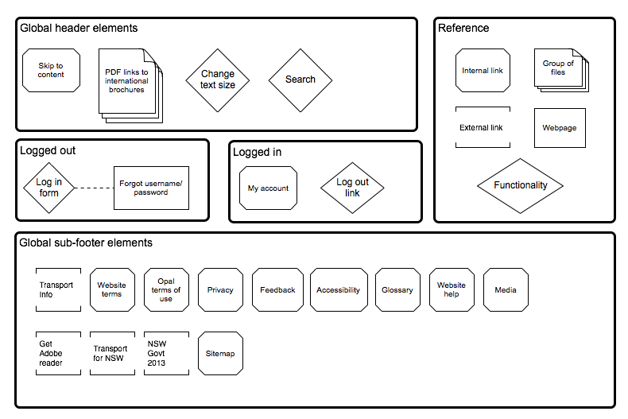
Current global

Slide 51
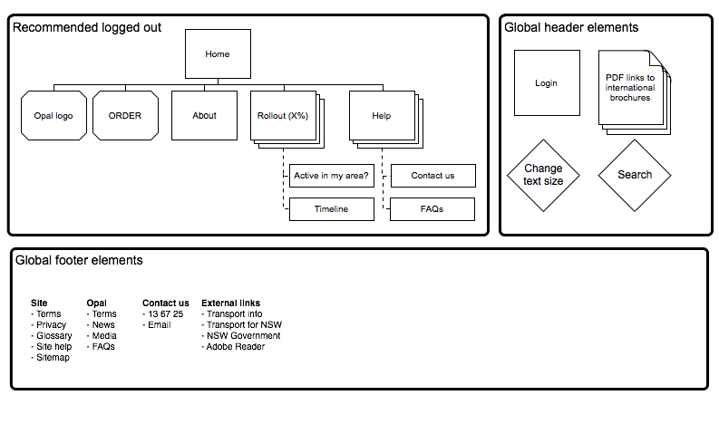
Recommended logged out

Slide 52
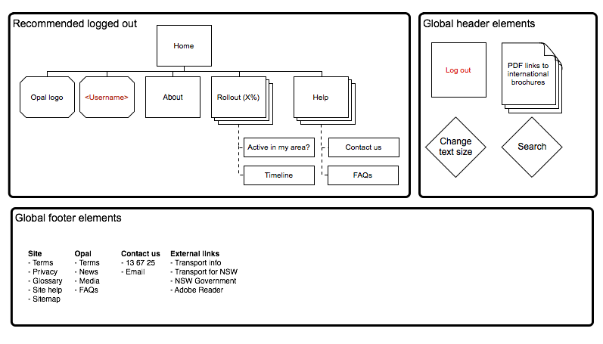
Recommended logged in

Slide 53
Wires
opal-ux.herokuapp.com
u/name: admin
p/word: opal@1234

Slide 54
Discussion

Slide 55
Thank you
Vlad Ivanovic
Digital Strategist
Office +61 2 9469 5954 Suite 5, 30 Boronia Street Redfern NSW 2016
@vladiim vlad.ivanovic@holler.com.au

